Slide 1

Factors affecting sleep quality
Group 5
313554024 林慧旻 313581011 洪明祺 313551099 李以恩 313551135 林念慈

Slide 2
Table of contents
01
02
03
04
05
06
Target Problem
Datasets
Analysis Workflow
Analysis Results
Discussion & Conclusion
Work Distribution

Slide 3
01
Target problem

Slide 4

Reasons behind Sleep Disorder
Age
Body Temperature
Stress and Emotional Disturbances
Poor Environment
Lifestyle
Exercise
Health Conditions and Medication

Slide 5
Problem Description
Input:
Sleep Health and Lifestyle Dataset, which covers a wide range of variables related to sleep and daily habits
Process:
Use Apriori to analyze the factors related to sleep disorders
Build models to predict people with sleep disorder
Use machine learning methods to conduct the project.
Output:
The presence or absence of a sleep disorder in the person
(None, Insomnia, Sleep Apnea)
Notes:
關於我們想探討的問題，我們的資料集是一個人的日常習慣與睡眠品質的紀錄，包含血壓、睡眠時長、一天走的步數等等。我們預計使用Apriori來抓出與睡眠障礙有關的feature，並且建立模型來預測人類有睡眠障礙的行為，我們預計訓練decision-tree和KNN模型，而最終的輸出則是預測個人是否無睡眠障礙、有失眠問題、還是有睡眠呼吸中止症的問題

Slide 6
02
Datasets

Slide 7

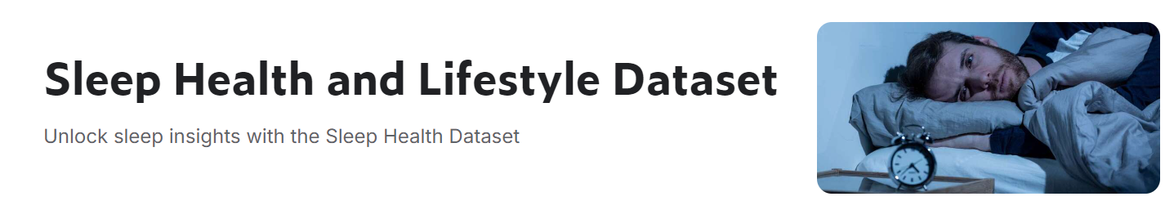
Dataset
Key Features of the Dataset:
Comprehensive Sleep Metrics
Lifestyle Factors
Cardiovascular Health
Sleep Disorder Analysis
Notes:
全面性的睡眠特徵分析
包含各種生活影響因素，包括生理性與心理性的影響
有把心血管健康納入考量，像是心跳頻率與血壓
分析這些人有哪些睡眠障礙，像是失眠、睡眠呼吸道中止症

Slide 8
Data Source
Data Download Source
The data is synthetic and created by Laksika Tharmalingam
Sleep Health and Lifestyle Dataset | Kaggle
The Amount of Columns
The Amount of Data
13
374

Slide 9
Column
Name | Type | Description
Person ID | Integer | An identifier for each individual
Gender | String | Male/Female
Age | Integer | The age of the person in years
Occupation | String | The occupation or profession of the person
Sleep Duration | Integer | The number of hours the person sleeps per day
Quality of Sleep | Integer | A subjective rating of the quality of sleep, ranging from 1 to 10

Slide 10
Name | Type | Description
Physical Activity Level | Integer | The number of minutes the person engages in physical activity daily
Stress Level | Integer | ranging from 1 to 10
BMI Category | String | Underweight, Normal, Overweight
Blood Pressure | Integer | Systolic/Diastolic
Heart Rate | Integer | bpm (beats per minute)
Daily Steps | Integer | The number of steps the person takes per day
Sleep Disorder | String | None, Insomnia, Sleep Apnea

Slide 11
03
Analysis workflow

Slide 12
Feature Engineering
Data Imbalance Handling
Data Imputation
Training
K-fold Cross Validation
Data Processing
Data Transformation
Feature Extraction
Modelling & Evaluation
Knowledge
Data Analysis
Visualization
Apriori
Feature Importance
Result & Analysis

Slide 13
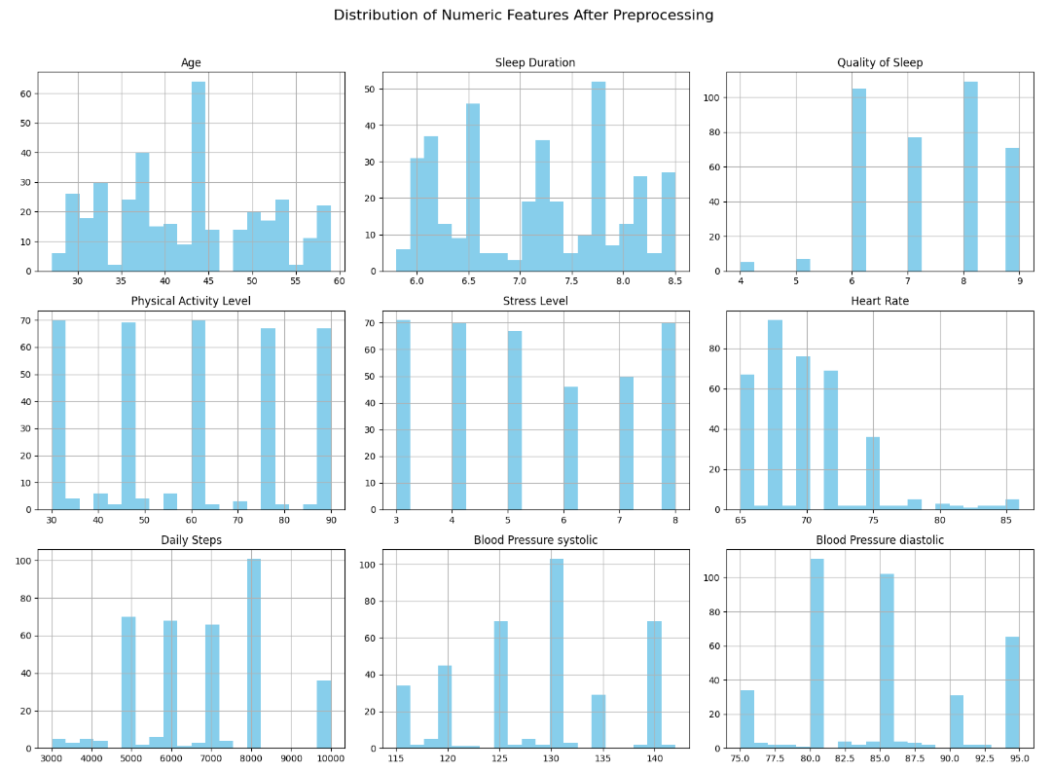
Visualization - Distribution of Numeric Features

Slide 14
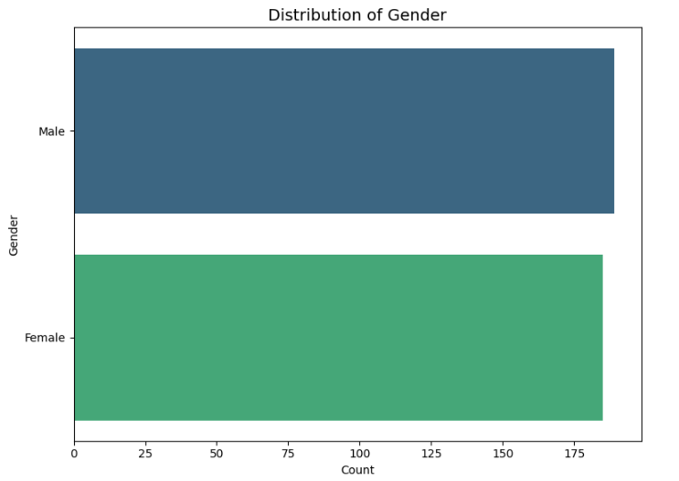
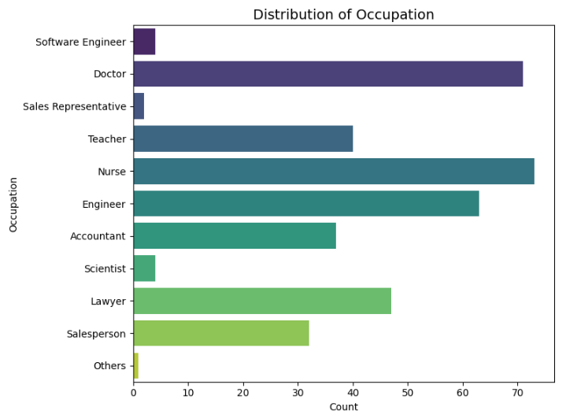
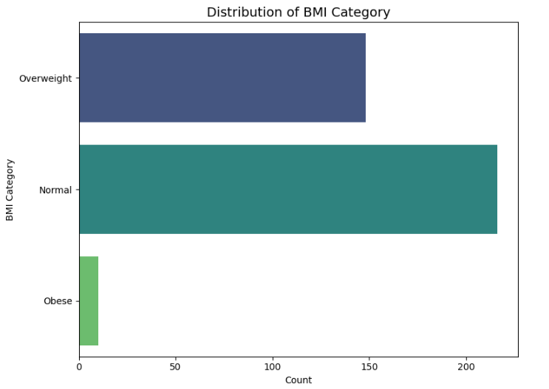
Visualization - Distribution of Categorical Features

Slide 15
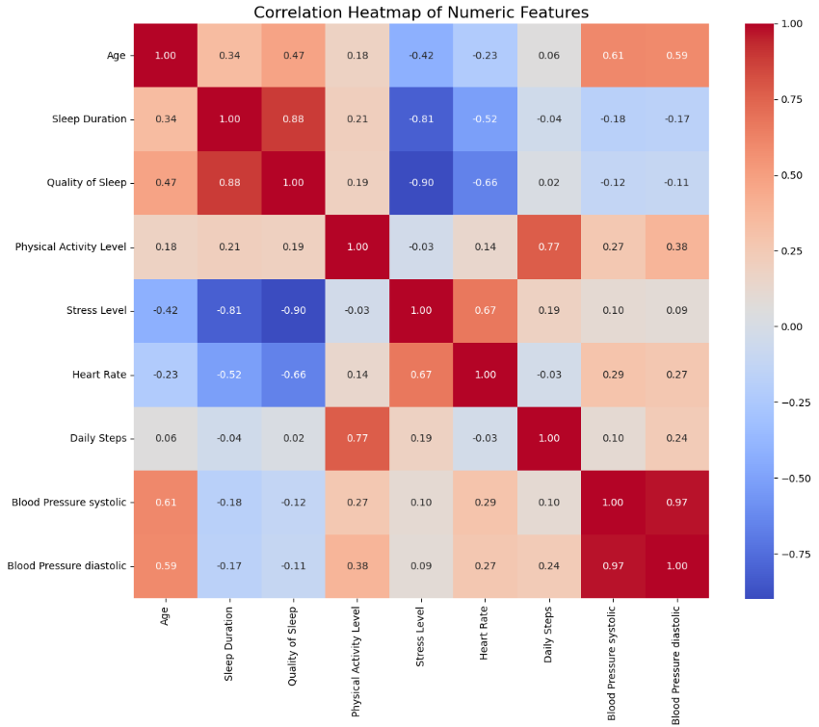
Visualization - Correlation of Numeric Features

Slide 16
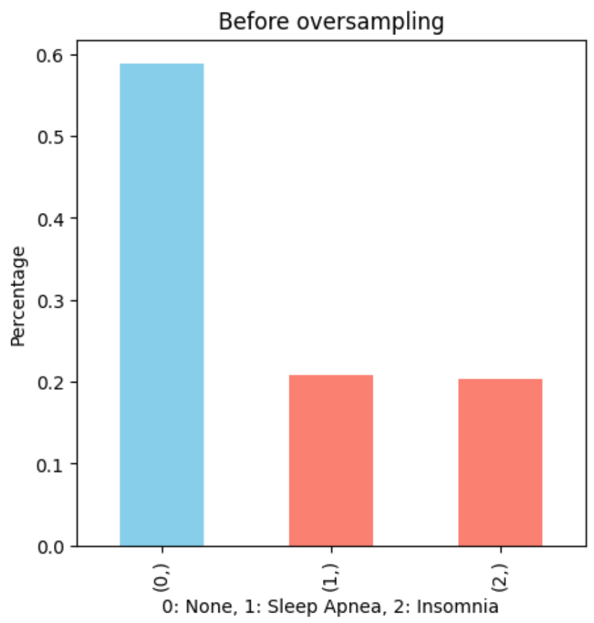
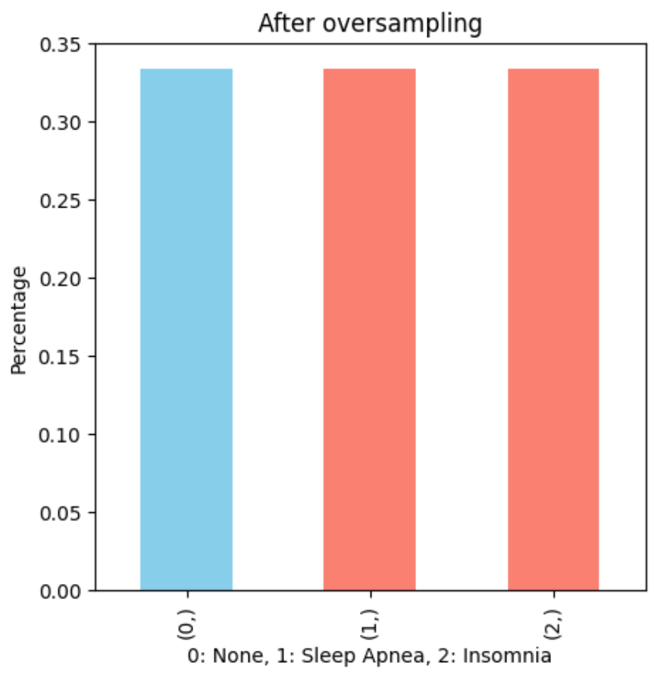
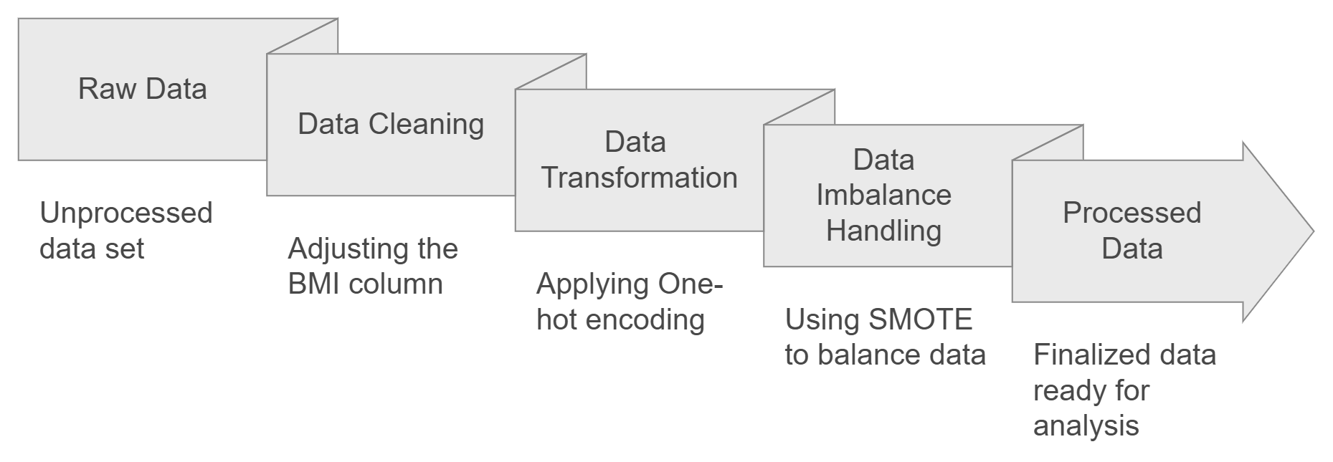
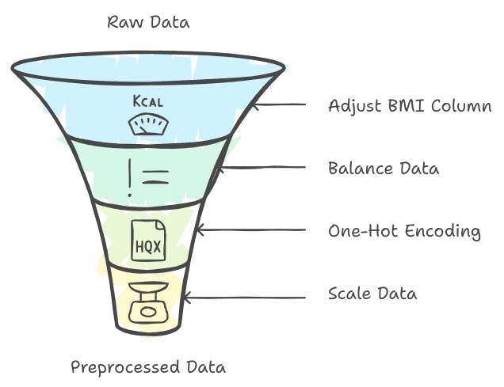
Data Preprocessing
Drop “Person ID”
Standardization

Slide 17
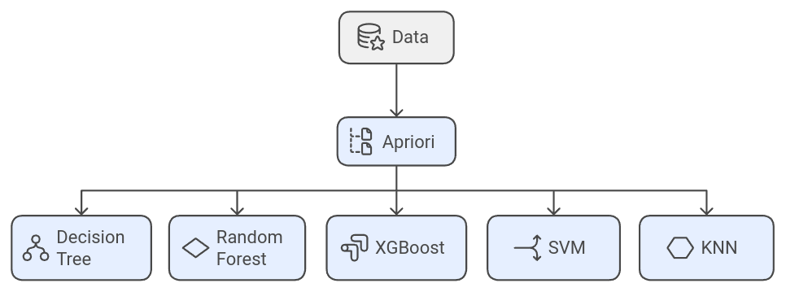
Feature Selection & Modeling
5-Fold Cross Validation
Test-Train Split
Training set 80%
Testing set 20%

Slide 18
04
Analysis results

Slide 19


Performance Metrics
Accuracy
Precision
Correct prediction
Total prediction
TP
TP + FP
Recall
F1 Score
TP
TP + FN
Precision×Recall
Precision+Recall​
X2
Notes:
我們預計紀錄Accuracy, Precision, Recall, 和F1 score來呈現我們模型的performance

Slide 20
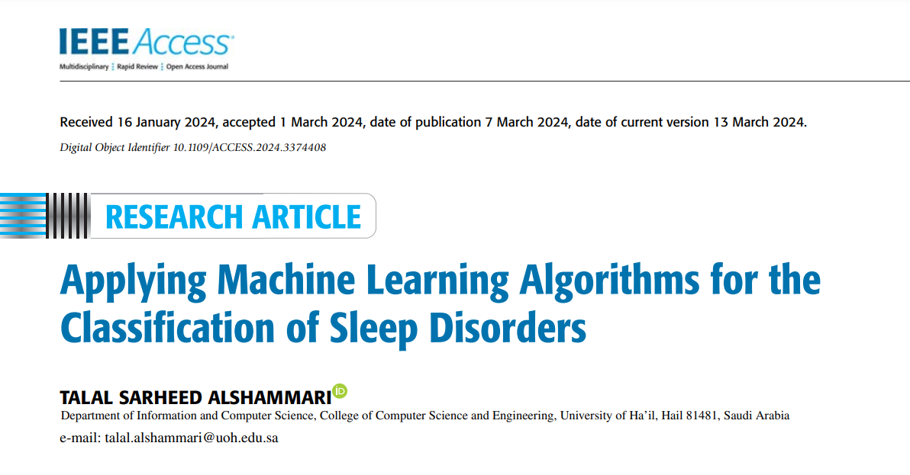
Baseline
Baseline:
Precision: 83.42%
Recall: 83.18%
F1 score: 83.21%
Accuracy: 83.19%
Notes:
我們預計紀錄Accuracy, Precision, Recall, 和F1 score來呈現我們模型的performance

Slide 21
Results
 | F1 Score | Accuracy | Precision | Recall
Decision Tree | 90.58% | 90.67% | 90.55% | 90.67%
Random Forest | 90.58% | 90.67% | 90.55% | 90.67%
XGBoost | 90.58% | 90.67% | 90.55% | 90.67%
SVM | 89.18% | 89.33% | 90.00% | 89.33%
KNN | 85.36% | 85.33% | 85.46% | 85.33%
Baseline | 83.21% | 83.19% | 83.42% | 83.18%

Slide 22
05
Discussion
& Conclusion

Slide 23
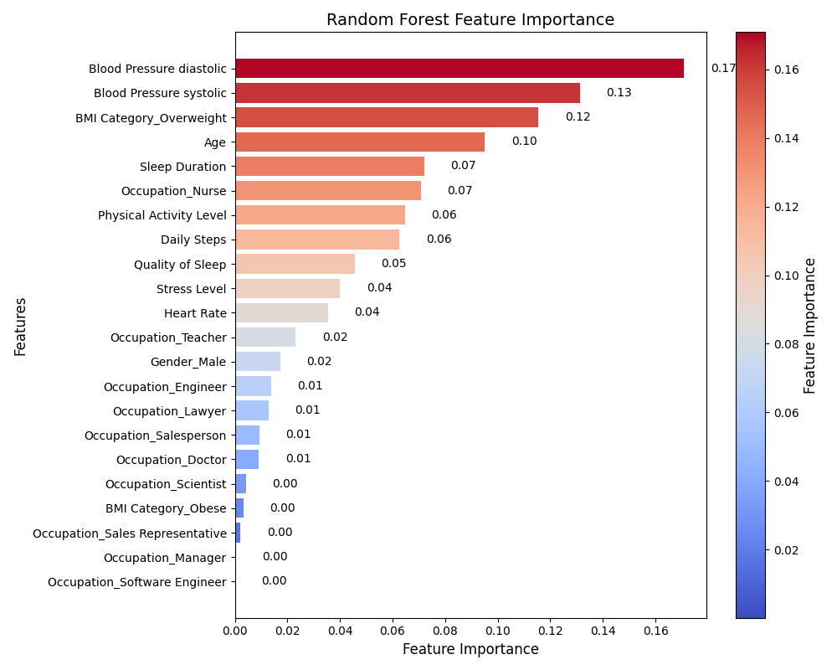
Feature Importance: Random Forest

Slide 24
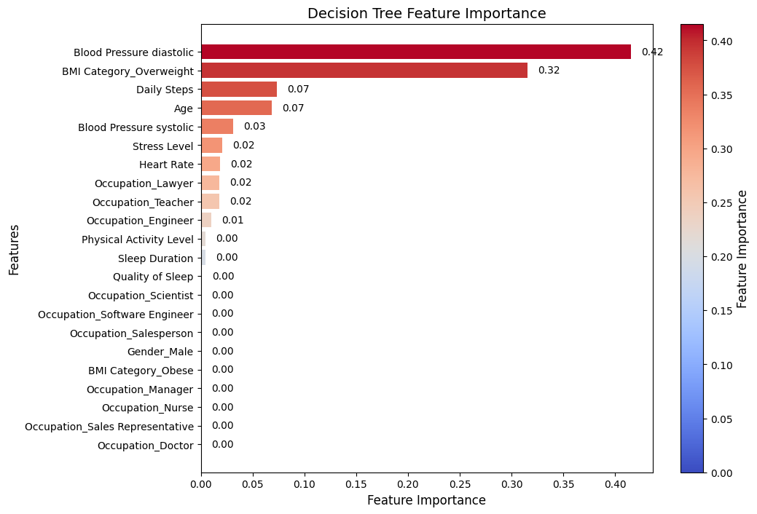
Feature Importance: Decision Tree

Slide 25
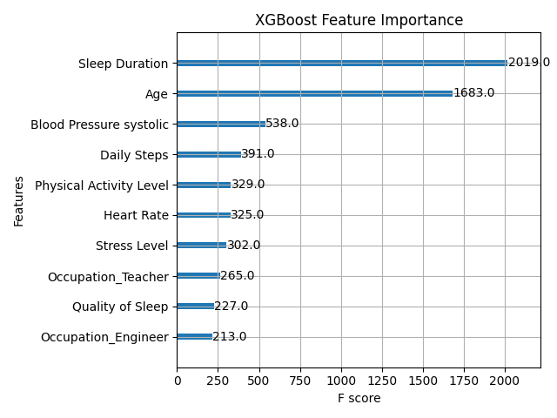
Feature Importance: XGBoost

Slide 26
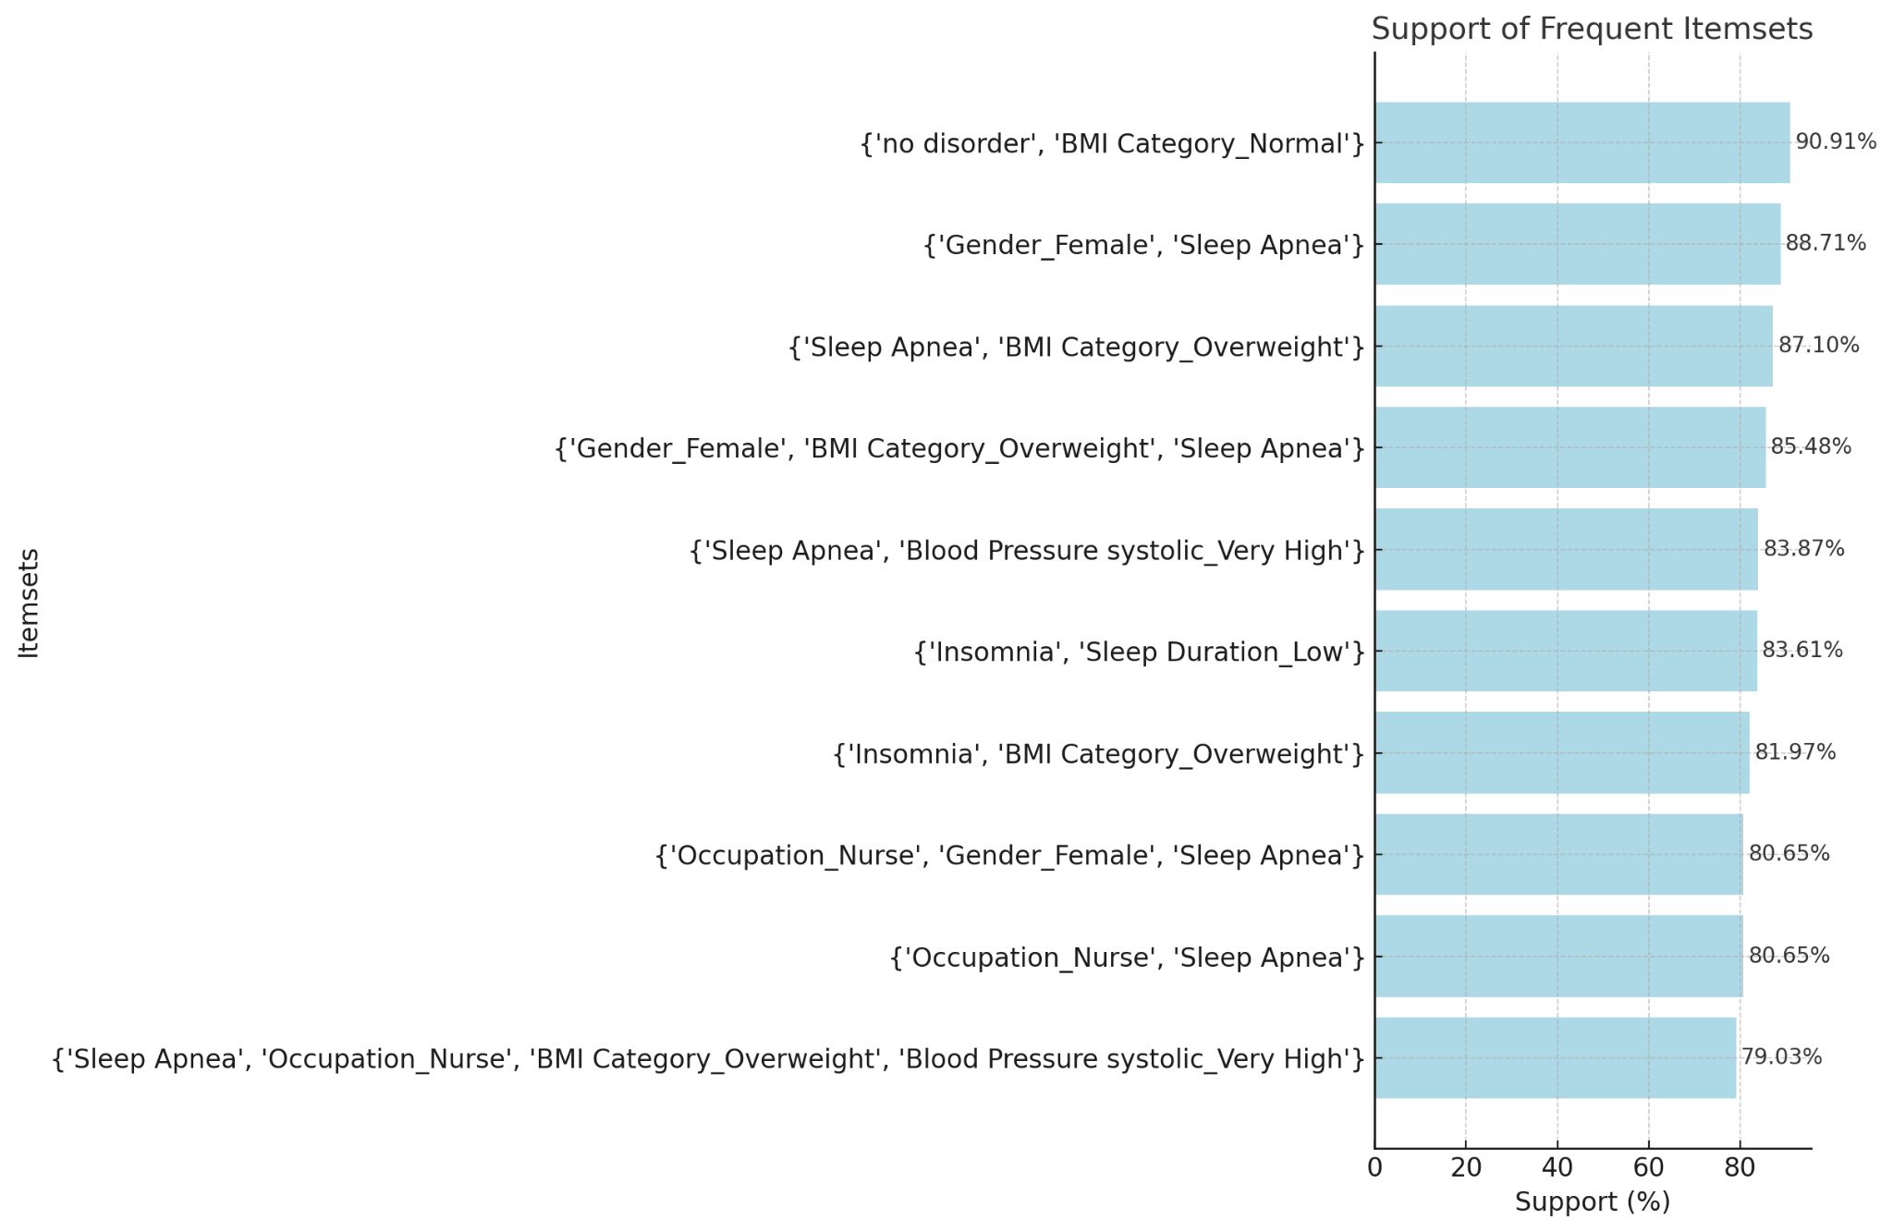
Apriori - Frequent Itemsets

Slide 27
Discussion
From feature importance of Random Forest and Decision Tree:
Blood pressure and BMI overweight are influential.
From feature importance of XGBoost:
Sleep duration and age are two critical effects of sleep disorder.
From the frequent itemsets of Apriori:
No disorder: BMI_Normal
Sleep Apnea: Gender_Female, BMI_Overweight, Blood Pressure systolic_Very High,
Insomnia: BMI_Overweight, Sleep Duration_Low
Notes:
國家睡眠基金會

Slide 28
Challenge
Handle data imbalance problem.
The size of the dataset is quite small.
Most models performed well, while KNN model need to do extra process to achieve better performance.
The 5 models are currently using default parameters. We can try using grid search to achieve better performance.
Notes:
國家睡眠基金會

Slide 29
Conclusion
Blood Pressure
BMI
Sleep Duration
Successfully identified factors related to sleep quality based on the dataset.
Compared to the reference literature, our preprocessing and model selection have achieved better results.
Sleep tight, keep BMI right, same time every night!
Notes:
國家睡眠基金會

Slide 30
06
Work distribution

Slide 31
Work Distribution Chart
林慧旻 | Data preprocessing, Data Analysis, Report
洪明祺 | Apriori, Model - KNN, Report
李以恩 | Model - Random Forest, XGBoost, SVM, Presentation
林念慈 | Feature Importance, Model - Decision Tree, Report
Notes:
關於我們想探討的問題，我們的資料集是一個人的日常習慣與睡眠品質的紀錄，包含血壓、睡眠時長、一天走的步數等等。我們預計使用Apriori來抓出與睡眠障礙有關的feature，並且建立模型來預測人類有睡眠障礙的行為，我們預計訓練decision-tree和KNN模型，而最終的輸出則是預測個人是否無睡眠障礙、有失眠問題、還是有睡眠呼吸中止症的問題

Slide 32
Thanks for listening! 😊

